Slide 1
Data Science Overview
1LT Noah DeMoes

Slide 2
Agenda
Define Data Science
Explore Applications and examples
Notes:
During the next 50 minutes I hope to provide a working definition of what Data Science is and what it is not. Today, people like to throw around words without properly understanding what they mean. We heard General Craft talk about his experience working with Futures Command. Almost every slide had some reference to AI Data Science machine learning, or the cloud. And while these are all related there are distinct attributes that delineate their difference. The reason this is important is two-fold. One, know the limitations of the people you are working with. If someone says they are an expert in machine learning, they may not be an expert in data science. Knowing this can hopefully set the conditions for success by not assuming someone has the skills required for a task when in reality they don’t. Second, as subject matter experts that the Senior Developer requires it is import that we know and understand the nuances within the Data Science domain and can articulate and use definitions and words properly.
Once we understand what data science is we will transition into some over arching applications in both the private sector and government arenas.

Slide 3
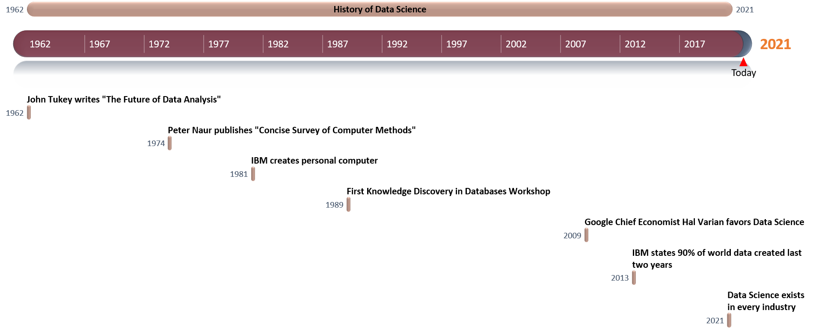
History of Data Science
Notes:
https://datasciencedegree.wisconsin.edu/blog/history-of-data-science/#:~:text=Pushing%20Rewind%20on%20Data%20Science&text=A%20trip%20into%20the%20history,analysis%20as%20an%20empirical%20science.
https://xaltius.tech/short-history-data-science/

Slide 4
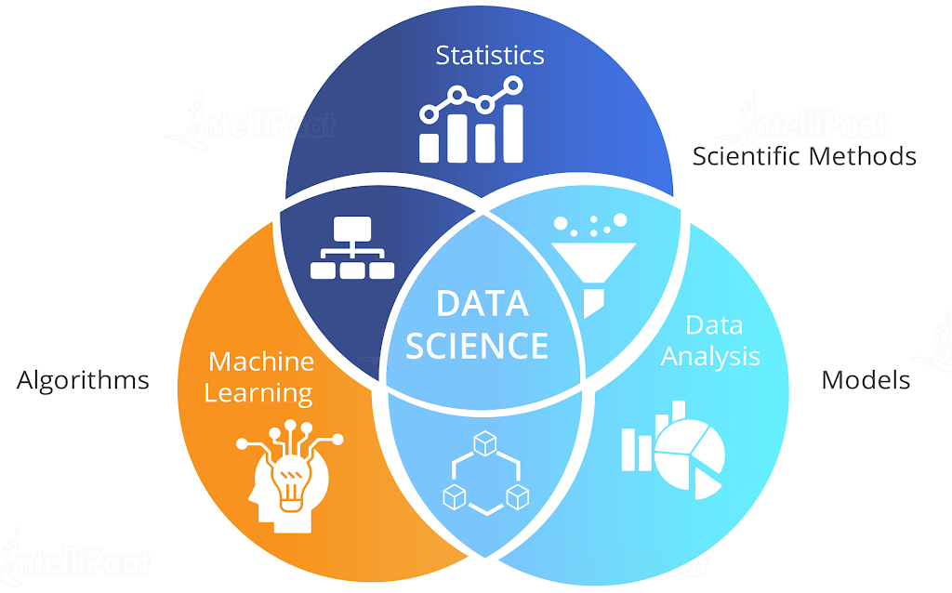
Data Science Definition
An interdisciplinary science that extracts value from data.
Notes:
Data Science vs Artificial Intelligence - Key Differences (intellipaat.com)

Slide 5
Data Science AI Comparison
Comparison Factor | Data Science | Artificial Intelligence
Meaning | Data Science aims to curate massive data for analytics and visualization | Artificial Intelligence helps in implementing data and the knowledge of machines
Skills | You need to use statistical techniques for development and design | You must use algorithms for development and design
Technique | Data Science makes use of the Data Analytics technique | AI uses Deep Learning and Machine Learning techniques
Observation | It looks for patterns in data to make well-informed decisions | It imposes intelligence in machines using data to make them respond as humans do
Solving Issues | It utilizes parts of a loop or program to solve issues | AI, however, represents the loop for planning and perception
Processing | It uses a medium level of data processing for data manipulation | It uses high-level processing of scientific data for data manipulation
Graphic | It allows you to represent data in several graphical formats | It helps you use an algorithm network node representation
Tools Involved | Data Science makes use of tools, such as SAS, SPSS, Keras, R, Python, etc. | AI uses tools viz. Shogun, Mahout, Caffe, PyTorch, TensorFlow, Scikit-Learn, etc.
Applications | Applications of Data Science are dominantly used in Internet search engines, such as Yahoo, Bing, Google, etc. | AI applications are used in several industries, including transport, healthcare, manufacturing, automation, etc.
Notes:
Data Science vs Artificial Intelligence - Key Differences (intellipaat.com)

Slide 6
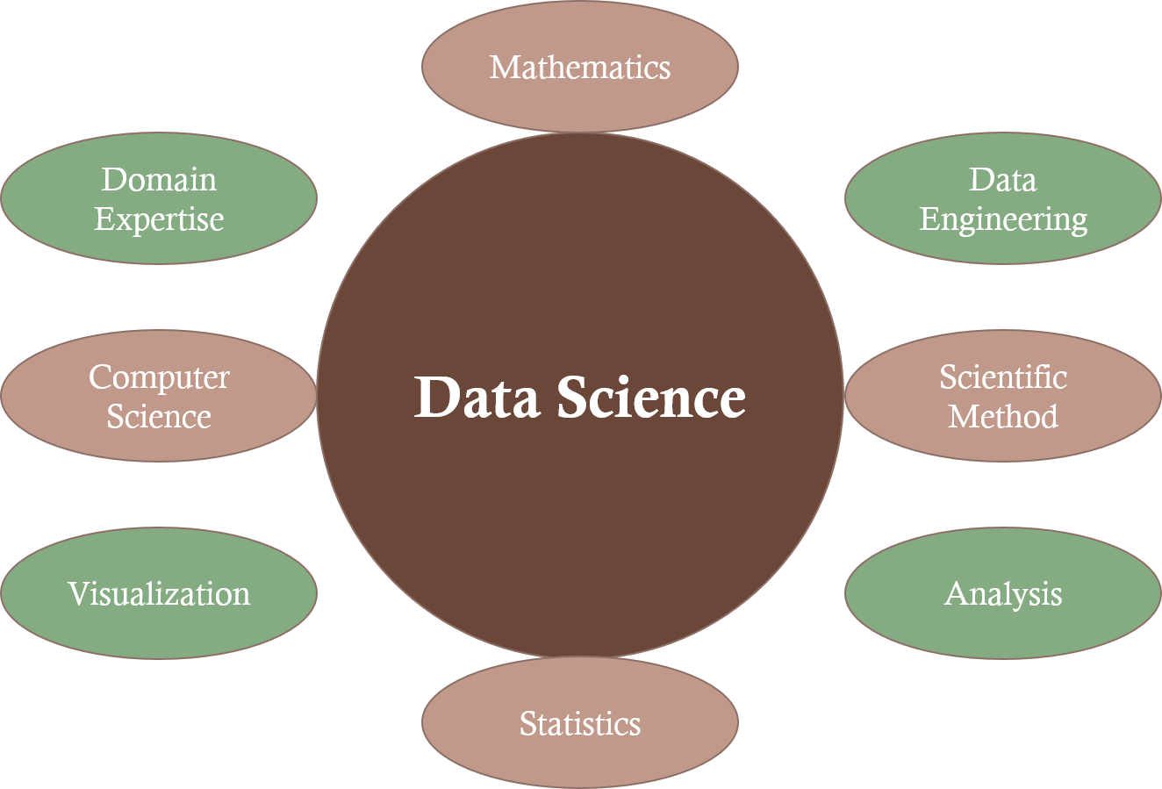
Data Science Components

Slide 7
Mathematics
Domain Expertise
Data Science
Data Engineering
Computer Science
Scientific Method
Visualization
Analysis
Statistics

Slide 8
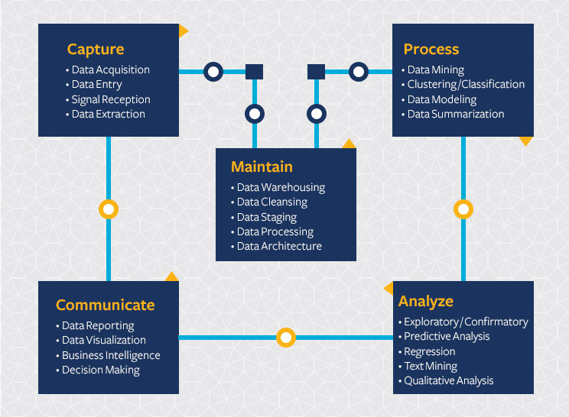
Data science Life Cycle
Notes:
https://ischoolonline.berkeley.edu/data-science/what-is-data-science/

Slide 9
Data Science Methods
Time Series
Logistic Regression
Random Forests
Decision Trees
Machine Learning
Neural Networks

Slide 10
Data Science Applications
Voice Recognition
Siri, Google Voice, Alexa
Fraud detection
Medical Image Analysis
Sports
Find undervalued players (Think MoneyBall) Liverpool did this an won the 2019 Premier League championship
Determine the best positions on the field or court
E-Commerce
Automated Ad placement
Product Recommendation
Social Media
LinkedIn recommend connections
Tinder recommends Matches
Facebook presents potential connections

Slide 11



Voice Recognition
Notes:
These are three examples of voice recognition. Amazon’s Alexa, Apple’s Siri, and Microsoft’s Cortana.
They all have voice recognition features or options that can be enabled that help each device recognize the voice that is speaking. Each of us comes from a different place in the country. You can imagine that a Bostonian does not have the same accent as someone in the South. Enabling these devices to train their speech to text models based on the individual can decrease the number of times it is thinking you want to look up a mime instead of the number 9.
What value is extracted from this data?
Increase user experience leading to increase use of product leading to increased loyalty and likelihood of returning customer.

Slide 12



Video recommendation systems
Notes:
Videos are presented in way that links to what has been previously watched.
Netflix give a Score for how much they think you will like the movie.
Value add?
Recommend content that the customer is likely going to enjoy leading to subscription retention

Slide 13



E-Commerce Applications
Product Recommendations
Personalized Advertisement

Slide 14

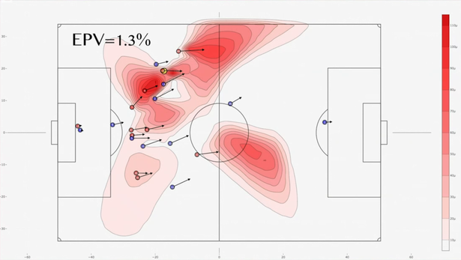
Sports – Liverpool 2019
Find undervalued players (2019 Liverpool)
Determine best strategy on the field that increases goal probability
Won 2019-2020 Premier League title
Notes:
How Math and Data Science Made Liverpool the Best Team on the Planet | by Viroshan Naicker | The Spekboom | Medium
Liverpool are using incredible data science during matches, and effects are extraordinary - Liverpool.com

Slide 15
Conclusions
Data Science spans multiple disciplines and seeks to find actionable insights from data
Applications exist in every domain

Slide 16

Questions

Slide 17

10 Minute Break

Slide 18
Statistics
POC: 1LT NOAH DEMOES 661-858-4337

Slide 19
Agenda
Mean Median Mode
Quartiles and Standard Deviation
Variance and Covariance
Z-scores and Confidence Intervals
P-values
A/B, T, Chi-Squared Tests
Central Limit Theorem (CLT)
Law of Large Numbers

Slide 20
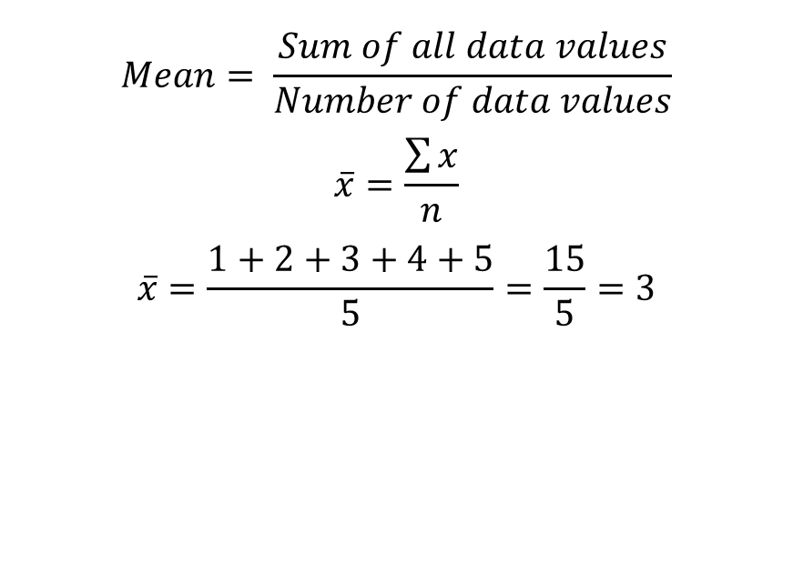
Mean
$$Mean= \frac{Sum of all data values}{Number of data values}$$
$$\overline{x}=\frac{\sum{x}}{n}$$
$$\overline{x}=\frac{1+2+3+4+5}{5}=\frac{15}{5}=3$$
import statistics as stats
array = [1, 2, 3, 4, 5]
stats.mean(example_array)

Slide 21
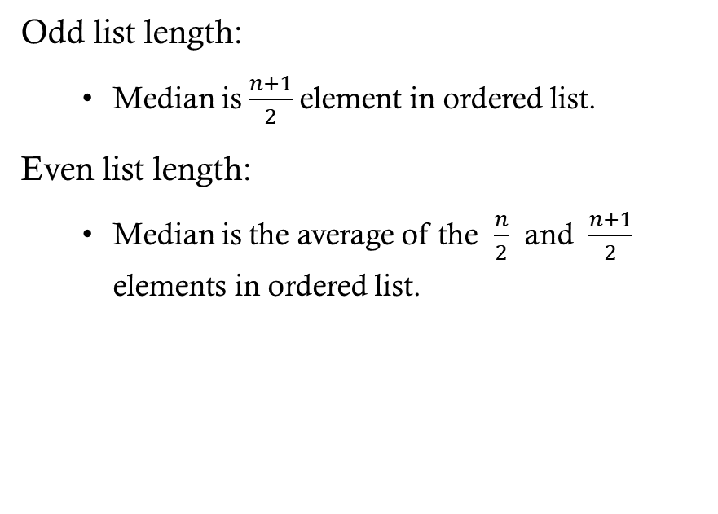
Median
Odd list length:
Median is $\frac{n+1}{2}$element in ordered list.
Even list length:
Median is the average of the $\frac{n}{2}$ and $\frac{n+1}{2}$ elements in ordered list.
import statistics as stats
array = [1, 2, 3, 3, 4, 5]
stats.median(example_array)
median = 3

Slide 22
MODE
The most frequent element.
import statistics as stats
array = [1, 2, 3, 3, 4, 5]
stats.mode(example_array)
mode = 3

Slide 23
Quartiles
Three values that split the provided data into four equal parts (25%, 50%, 75%).
import statistics as stats
array = [1, 2, 3, 4, 9, 5]
stats.quantiles(array, n=4)=
[1.75, 3.5, 6.0]

Slide 24
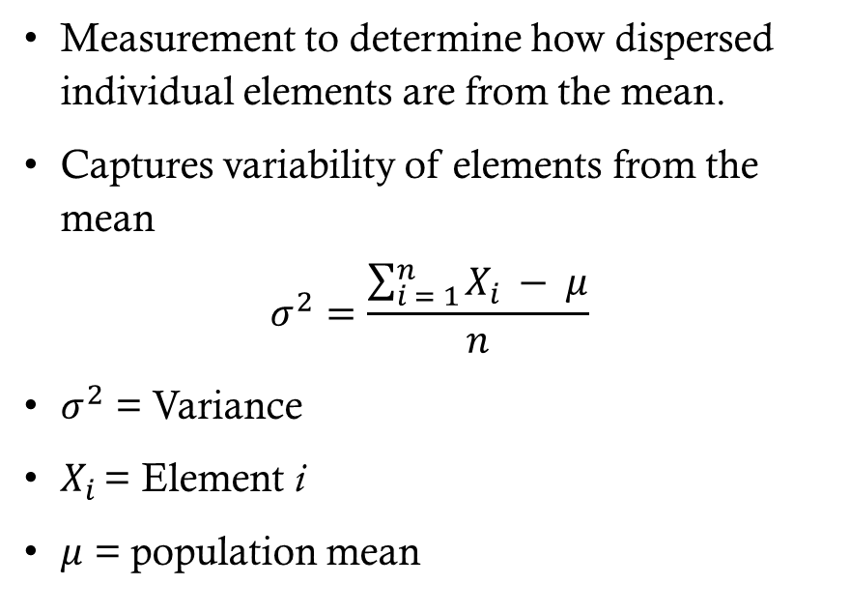
Variance
Measurement to determine how dispersed individual elements are from the mean.
Captures variability of elements from the mean
$$σ^{2}=\frac{\sum_{i = 1}^{n}{X_{i }− μ}}{n}$$
$σ^{2}$ = Variance
$X_{i }$= Element i
$μ$ = population mean
import statistics as stats
array = [1, 2, 3, 4, 9, 5]
stats.variance(array)= 8

Slide 25
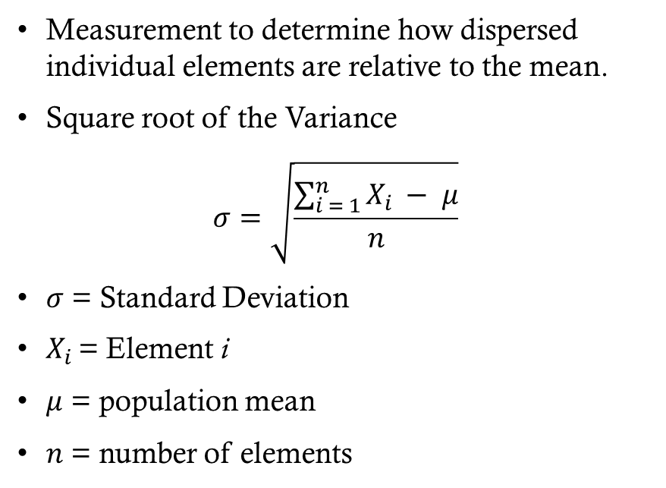
Standard Deviation
Measurement to determine how dispersed individual elements are relative to the mean.
Square root of the Variance
$$σ=\sqrt{\frac{\sum_{i = 1}^{n}{X_{i }− μ}}{n}}$$
$σ$ = Standard Deviation
$X_{i }$= Element i
$μ$ = population mean
$n$ = number of elements
import statistics as stats
array = [1, 2, 3, 4, 9, 5]
stats.stdev(array)= 2.82843

Slide 26
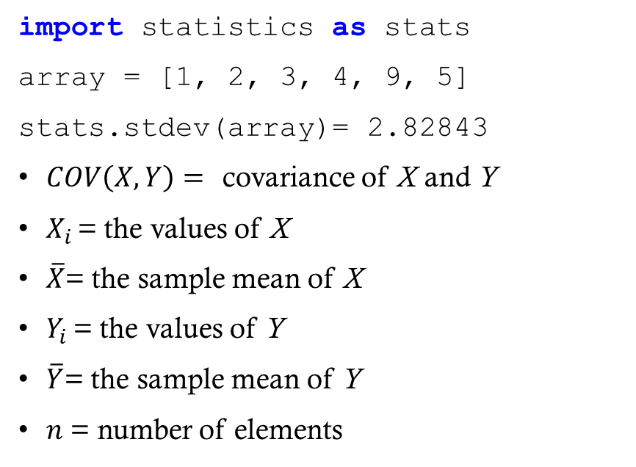
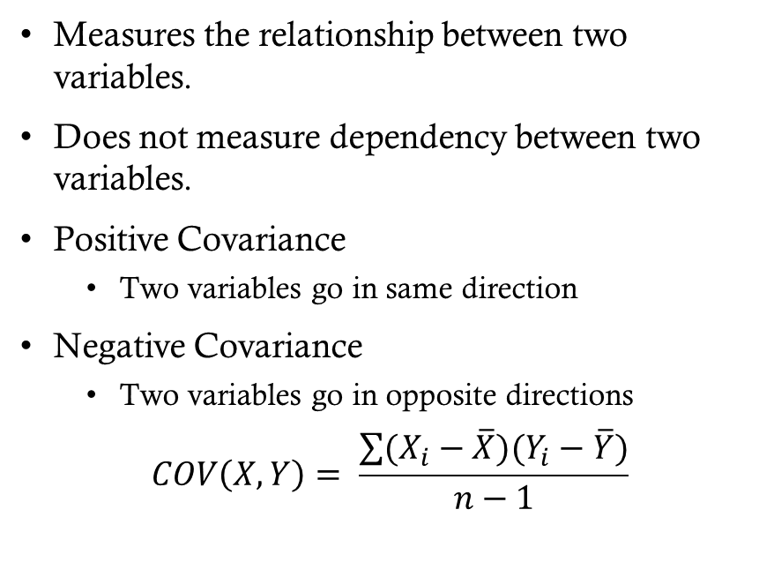
Covariance
Measures the relationship between two variables.
Does not measure dependency between two variables.
Positive Covariance
Two variables go in same direction
Negative Covariance
Two variables go in opposite directions
$$COV\left(X,Y\right)= \frac{\sum{(X_{i}−\overline{X})(Y_{i}−\overline{Y})}}{n−1}$$
import statistics as stats
array = [1, 2, 3, 4, 9, 5]
stats.stdev(array)= 2.82843
$COV\left(X,Y\right)=$ covariance of X and Y
$X_{i }$= the values of X
$\overline{X}$= the sample mean of X
$Y_{i }$= the values of Y
$\overline{Y}$= the sample mean of Y
$n$ = number of elements

Slide 27
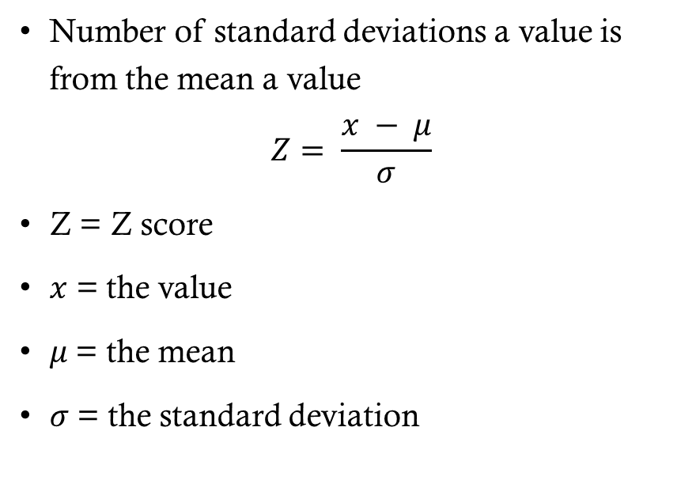
Z-score
Number of standard deviations a value is from the mean a value
$$Z= \frac{x − μ}{σ}$$
Z = Z score
$x$ = the value
$μ$= the mean
$σ$= the standard deviation

Slide 28
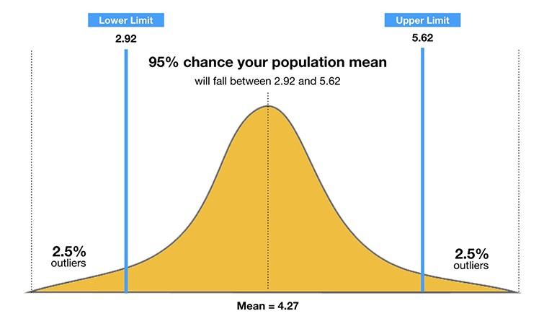
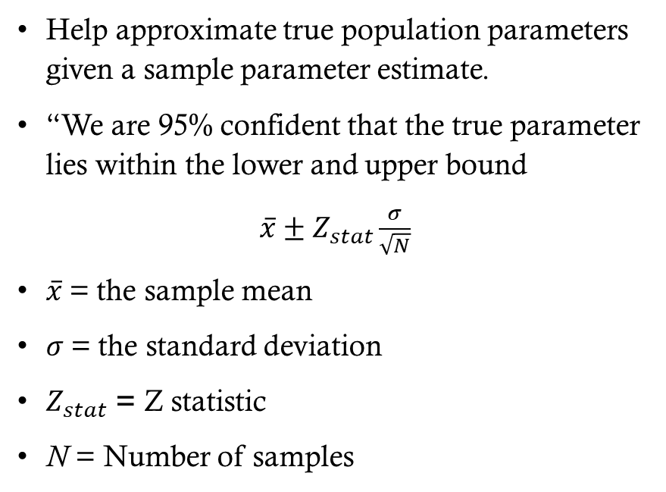
Confidence interval
Help approximate true population parameters given a sample parameter estimate.
“We are 95% confident that the true parameter lies within the lower and upper bound
$\overline{x}±Z_{stat}\frac{σ}{\sqrt{N}}$
$\overline{x}$= the sample mean
$σ$= the standard deviation
$Z_{stat}$ = Z statistic
N = Number of samples
Notes:
Are we studying a population or a sample?
Often we don’t have the resources or ability to measure the entire population so we use techniques to allow us to test a sample and still achieve meaningful results.
Building Confidence Interval using Python’s NumPy | by Vishal Sharma | The Startup | Medium

Slide 29
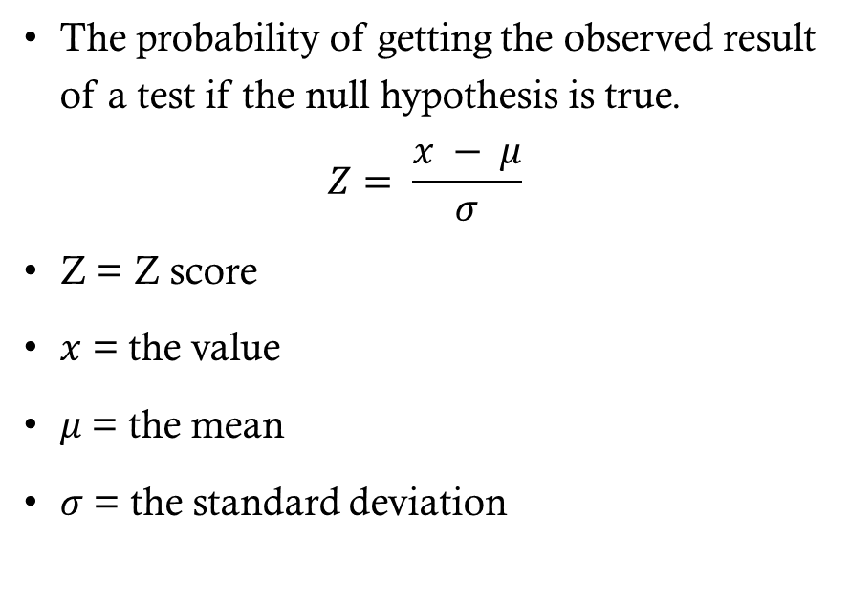
P-values
The probability of getting the observed result of a test if the null hypothesis is true.
$$Z= \frac{x − μ}{σ}$$
Z = Z score
$x$ = the value
$μ$= the mean
$σ$= the standard deviation

Slide 30
What are we testing?
Hypothesis tests!
Remember that this is a Science and one of the 8 components of Data Science is the Scientific Method

Slide 31
Rules for testing
Create a Null Hypothesis
Determine Type of Test (A/B, T, CHI)
Determine Critical Value
Run Test
Determine whether to reject or fail to reject null hypothesis
Notes:
https://towardsdatascience.com/machine-learning-chi-square-test-in-evaluating-predictions-486404dd5bc

Slide 32
A/B Test
Experimental technique to determine whether a change in conditions results in an improvement for a given metric.

Slide 33
T-Test
Inferential statistic to test whether there is a difference between two groups
Is male height the same between Americans and Europeans?
Group sizes of at least 30
Remember! Reject or fail to reject null hypothesis, never accept it.
Critical value tells us whether to reject or fail

Slide 34
CHI2-Test

Slide 35
Central limit theorem (CLT)
The central limit theorem states that if you have a population with mean μ and standard deviation σ and take sufficiently large random samples from the population with replacement , then the distribution of the sample means will be approximately normally distributed.

Slide 36
Law of large numbers
States that as the number of samples approaches the true population size the difference between the sample mean and the population mean approach zero

Slide 37
Questions

Slide 38
10 Minute Break

Slide 39
Data Visualization
POC: 1LT NOAH DEMOES 661-858-4337

Slide 40
Agenda
Scatter Plot
Line Plot
Histogram
Bar Plot
Contour Plot
Facets

Slide 41
What is a graphic?
Common statistical plots:
Scatter plot
Line plot
Box plot
Histogram
Bar plot
Notes:
A graphic is a visual representation of information.

Slide 42
What are the common elements?
Some type of data
Maps data to aspects of the plot
Geometric in nature
Statistical transformation
Coordinate systems
Notes:
A graphic is a visual representation of information.

Slide 43
How are these plots Related?
Scatter Plot
Maps variables to x-axis and y-axis
Uses points to represent each observation
Line Plot
Maps variables to x-axis and y-axis
Uses lines to connect each observation
Histogram
Maps bins to x-axis and frequencies to y-axis
Uses bars to represent bin frequency
Bar Plot
Maps categorical variable to x-axis and counts to y-axis
Uses bars to represent category frequency
Box Plot
Maps 5-number summary ( min, lower-hinge, median, upper-hinge, max) to y-axis
Uses shapes to represent values (box and whiskers)
Notes:
A graphic is a visual representation of information.

Slide 44
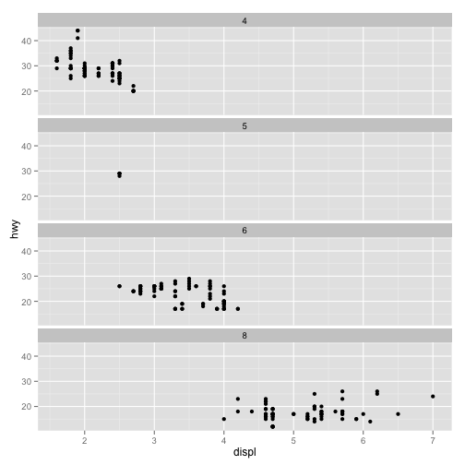
How are these plots Related?
Contour Plot
Maps three-dimensional surface to a two-dimensional surface
Maps variables to x-axis and y-axis
Uses contour lines to connect points of same response value
Color bands between contours to represent range of values
Facets
Matrix of two-dimensional graphs partitioned by a third variable
Notes:
A graphic is a visual representation of information.

Slide 45
Questions

Slide 46
10 Minute Break

Slide 47
Data Processing
POC: 1LT NOAH DEMOES 661-858-4337

Slide 48
Agenda
Purpose of Data Processing
Normalization/rescaling methods
Encoding schemes
Data cleaning techniques

Slide 49
What is Data Preprocessing/processing?
A data science procedure in which data transforms into a clean, machine-interpretable format.

Slide 50
Why do we need to Process Data?
Missing, Duplicate, Inconsistent values
Outliers
Feature Enrichment
Feature Encoding
Dimensionality Reduction
Imbalanced data

Slide 51
Processing values
Missing Values
Remove entries with missing values
Impute values for those missing
Duplicate Values
Remove Duplicates
Inconsistent Values
Create consistent format (Date, Address, Phone number, etc.)
Outliers
Remove

Slide 52
Normalization / Rescale
Normalization gives equal weight/importance to each variable
(Rescaling) Min-Max normalization
Mean normalization
Z-score normalization

Slide 53
Encoding schemes
One hot encoding: Convert label encoding to a non-ordering relationship variable
Binarization: Convert variable into 0s and 1s based on a fixed threshold.
Discretization: Split a continuous variable into categories or groups
Equal Width, Equal Frequency, K means
Notes:
An Introduction to Discretization Techniques for Data Scientists | by Rohan Gupta | Towards Data Science

Slide 54
One Hot Encoding
Car Maker | Categorical Value | Price
Passat | 1 | 12000
Civic | 2 | 10000
Accord | 3 | 14000
Accord | 3 | 15000
Passat | Civic | Accord | Price
1 | 0 | 0 | 1200
0 | 1 | 0 | 10000
0 | 0 | 1 | 14000
0 | 0 | 1 | 15000
Label Encoding
One-hot Encoding

Slide 55
Binarization
Passat | Civic | Accord | Price
1 | 0 | 0 | 1200
0 | 1 | 0 | 1000
0 | 0 | 1 | 14000
0 | 0 | 1 | 15000
Passat | Civic | Accord | Price
1 | 0 | 0 | 0
0 | 1 | 0 | 0
0 | 0 | 1 | 1
0 | 0 | 1 | 1

Slide 56
Discretization
Transforming continuous data into discrete data (categories or bins)
Height is a continuous variable that can be transformed into short, average, tall bins
Short (less than 60 in)
Average ( between 60-71 inches)
Tall (greater than 71 inches)
Notes:
https://www.kaggle.com/mustafaali96/weight-height

Slide 57
Feature enrichment
The addition and/or transformation of features in increase the variance within the dataset to produce more robust models.
Supplement data with data from other sources
Feature Selection
Feature Transformation
Data Imputation

Slide 58
Transformations
Utilized to make your data work better for you
Numerical Transformations
Categorical Transformations
Notes:
Catalog of Variable Transformat
Data Transformation. Understanding why the “Unsexy”… | by Goutham Dommaraju | Towards Data Scienceions To Make Your Model Work Better | by Moto DEI | Towards Data Science

Slide 59
Questions

Slide 60
10 Minute Break

Slide 61
Performance metrics and techniques
POC: 1LT NOAH DEMOES 661-858-4337

Slide 62
Agenda
Cross Validation
Grid Search / parameter tuning
Metrics
Loss Functions
Area under the curve (AUC)
Type 1 error and Type 2 error
Confusion matrix
Validation Accuracy

Slide 63
Loss Functions
Machine learning is algorithmic and relies on loss functions to achieve expected performance
Regression Losses
Mean Squared Error (L2 loss)
Mean Absolute Error (L1 loss)
Huber
Categorical Losses
(Cross-Entropy) Negative log likelihood
Hinge
Notes:
A majority of machine learning is algorithms. You supply some data and the algorithm iterates over the data and alters the model coefficients until the model performs to a specified performance metric. In order to achieve the performance, the algorithm uses the loss function to modify model coefficients. Different loss functions alter coefficients differently. Thus, picking the right loss function for the problem at hand is important.

Slide 64
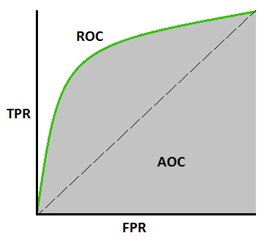

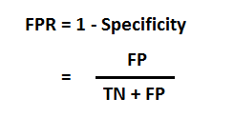
Area under the curve (AUC)
Higher AUC = Better prediction performance
Utilized for Binary Classification
TPR = True positive rate
FPR = False positive rate
Notes:
https://towardsdatascience.com/understanding-auc-roc-curve-68b2303cc9c5

Slide 65
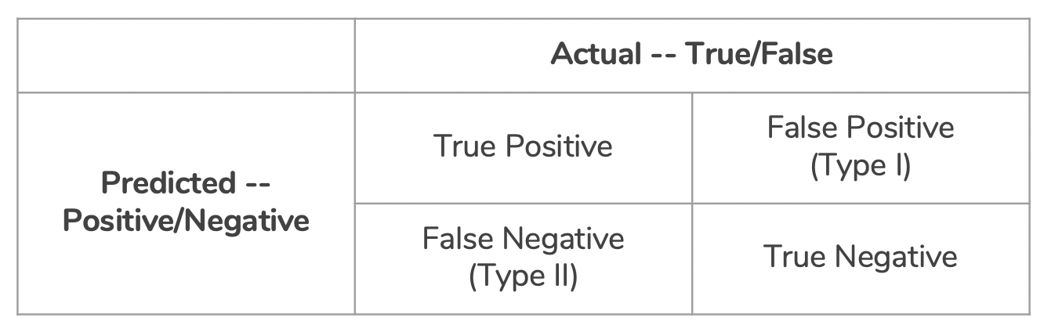
Type 1 vs Type 2 Error
Type 1 (false positive):
Test says you have COVID, but you don’t
Type 2 (false negative):
Test says you don’t have COVID, but you do
Notes:
https://towardsdatascience.com/taking-the-confusion-out-of-confusion-matrices-c1ce054b3d3e#:~:text=Confusion%20matrices%20have%20two%20types,Type%20I%20and%20Type%20II.&text=False%20Positive%20is%20a%20Type,making%20it%20a%20Type%20II.

Slide 66
Confusion Matrix
Accuracy (all correct / all) = TP + TN / TP + TN + FP + FN
Misclassification (all incorrect / all) = FP + FN / TP + TN + FP + FN
Precision (true positives / predicted positives) = TP / TP + FP
Sensitivity aka Recall (true positives / all actual positives) = TP / TP + FN
Specificity (true negatives / all actual negatives) =TN / TN + FP
Notes:
https://towardsdatascience.com/taking-the-confusion-out-of-confusion-matrices-c1ce054b3d3e#:~:text=Confusion%20matrices%20have%20two%20types,Type%20I%20and%20Type%20II.&text=False%20Positive%20is%20a%20Type,making%20it%20a%20Type%20II.

Slide 67
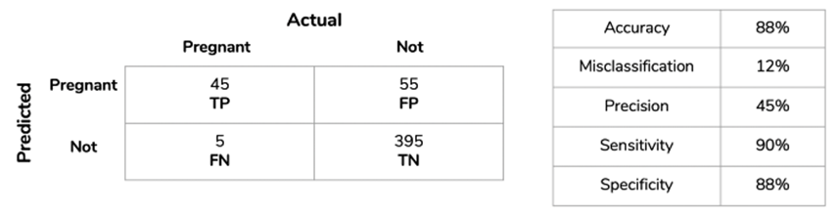
Confusion Matrix
Notes:
https://towardsdatascience.com/taking-the-confusion-out-of-confusion-matrices-c1ce054b3d3e#:~:text=Confusion%20matrices%20have%20two%20types,Type%20I%20and%20Type%20II.&text=False%20Positive%20is%20a%20Type,making%20it%2
0a%20Type%20II.

Slide 68
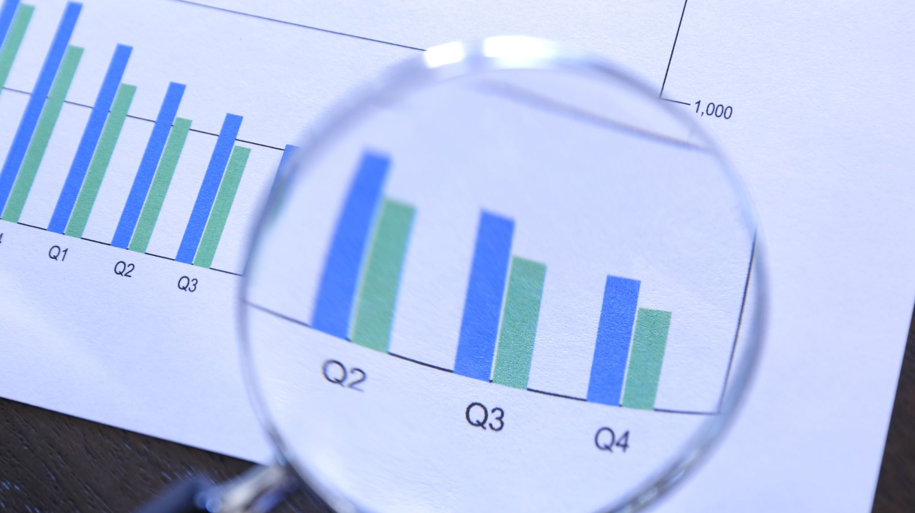
What do we do with these Metrics?

Slide 69
Parameter Tuning
There are several parameters that can hold different values
We must decide which values are best for our model.
One method is grid search:
Take all combinations of desired parameters and test each one. Select the parameter combination that yields the highest performance value for the selected performance metric.

Slide 70
Cross-Validation
Split data into k-splits.
Hold out one split as the test data and use the remaining k-1 splits as test data.
Record the performance metric for model
Repeat k times
Less variance in performance across k models results in higher validation of model

Slide 71
Questions

Slide 72
10 Minute Break

Slide 73
Data Analysis
POC: 1LT NOAH DEMOES 661-858-4337

Slide 74
Agenda
Correlation analysis
Mean distribution analysis
Advanced data analysis

Slide 75
Questions

Slide 76
10 Minute Break

Slide 77
How TO: Measures of Centrality
import statistics as stats
example_array = [1, 2, 3, 4, 9, 5]
example_array_mean = stats.mean(example_array)
example_array_median = stats.median(example_array) example_array_mode = stats.mode(example_array)

Slide 78
Recommendation Systems
Filter information in order to predict a user’s rating or preference of a particular item
Two main Recommendation systems
Collaborative filtering
Focuses on users
People that agreed in the past will likely agree in the future
Content-based filtering
Focuses on items
Compare items with each other and recommend items that are like items that received high ratings from the specified user in the past

Slide 79
15454 days
1 day
1 day
1 day
1 day
1 day
1 day
1 day
1962
1962
History of Data Science
2021
1962
1967
1972
1977
1982
1987
1992
1997
2002
2007
2012
2017
2021
Today
John Tukey writes "The Future of Data Analysis"
1962
Peter Naur publishes "Concise Survey of Computer Methods"
1974
IBM creates personal computer
1981
First Knowledge Discovery in Databases Workshop
1989
Google Chief Economist Hal Varian favors Data Science
2009
IBM states 90% of world data created last two years
2013
Data Science exists in every industry
2021
Notes:
https://xaltius.tech/short-history-data-science/

